Slide 1
Chapter 4
Euclidean Vector Spaces
4.1 Euclidean n-Space
4.2 Linear Transformations from R^{n} to R^{m}
4.3 Properties of Linear Transformations R^{n} to R^{m}

Slide 2
4.1 Euclidean n-Space

Slide 3
Definition
Vectors in n-Space
If n is a positive integer, then an ordered n-tuple is a sequence of n real numbers (a₁,a₂,…,a_{n}).. The set of all ordered n-tuple is called n-space and is denoted by R^{n}

Slide 4



Definition
Two vectors u=(u₁ ,u₂ ,…,u_{n}) and v=(v₁ ,v₂ ,…, v_{n}) in R^{n} are called equal if
The sum u+v is defined by
and if k is any scalar, the scalar multiple ku is defined by

Slide 5
The operations of addition and scalar multiplication in this definition are called the standard operations on R^{n}.
The Zero vector in R^{n} is denoted by 0 and is defined to be the vector 0=(0,0,…,0)
If u=(u₁ ,u₂ ,…,u_{n}) is any vector in R^{n} , then the negative( or additive inverse) of u is denoted by –u and is defined by -u=(-u₁ ,-u₂ ,…,-u_{n})
The difference of vectors in R^{n} is defined by
v-u=v+(-u) =(v₁-u₁ ,v₂-u₂ ,…,v_{n}-u_{n})

Slide 6
Theorem 4.1.1
Properties of Vector in R^{n}
If u=(u₁ ,u₂ ,…,u_{n}), v=(v₁ ,v₂ ,…, v_{n}) , and w=(w₁ ,w₂ ,…, w_{n}) are vectors in R^{n} and k and l are scalars, then:
(a) u+v = v+u (b) u+(v+w) = (u+v)+w
(c) u+0 = 0+u = u (d) u+(-u) = 0; that is u-u = 0
(e) k(lu) = (kl)u (f) k(u+v) = ku+kv
(g) (k+l)u = ku+lu (h) 1u = u

Slide 7
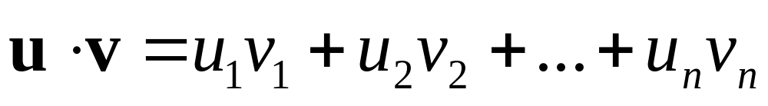
Definition
Euclidean Inner Product
If u=(u₁ ,u₂ ,…,u_{n}), v=(v₁ ,v₂ ,…, v_{n}) are vectors in R^{n} , then the Euclidean inner product u٠v is defined by

Slide 8
Example 1
Inner Product of Vectors in R⁴
The Euclidean inner product of the vectors
u=(-1,3,5,7) and v=(5,-4,7,0)
in R⁴ is
u٠v=(-1)(5)+(3)(-4)+(5)(7)+(7)(0)=18

Slide 9


Theorem 4.1.2
Properties of Euclidean Inner Product
If u, v and w are vectors in R^{n} and k is any scalar, then
(a) u٠v = v٠u
(b) (u+v)٠w = u٠w+ v٠w
(c) (k u)٠v = k(u٠v)
(d) Further, if and only if v=0

Slide 10
Example 2
Length and Distance in R⁴
(3u+2v)٠(4u+v) = (3u)٠(4u+v)+(2v)٠(4u+v)
= (3u)٠(4u)+(3u)٠v
+(2v)٠(4u)+(2v)٠v
=12(u٠u)+11(u٠v)+2(v٠v)

Slide 11
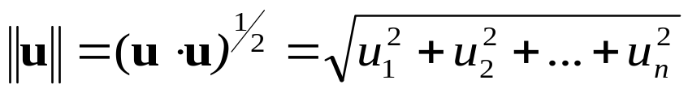
Norm and Distance in Euclidean n-Space
We define the Euclidean norm (or Euclidean length) of a vector u=(u₁ ,u₂ ,…,u_{n}) in R^{n} by
Similarly, the Euclidean distance between the points u=(u₁ ,u₂ ,…,u_{n}) and v=(v₁ , v₂ ,…,v_{n}) in R^{n} is defined by

Slide 12
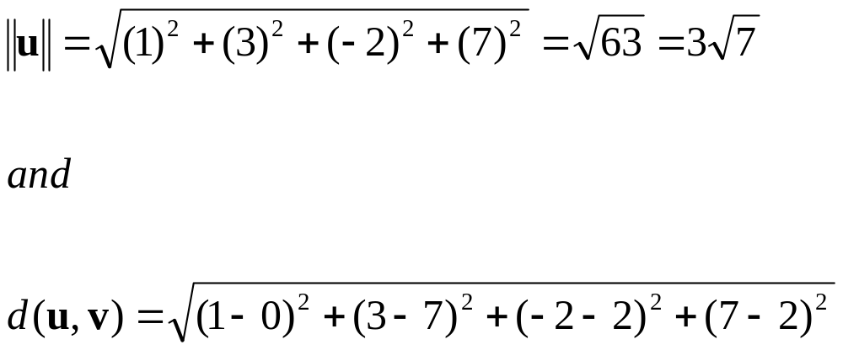
Example 3
Finding Norm and Distance
If u=(1,3,-2,7) and v=(0,7,2,2), then in the Euclidean space R⁴

Slide 13
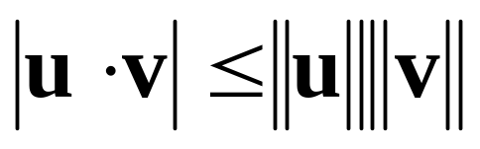
Theorem 4.1.3
Cauchy-Schwarz Inequality in R^{n}
If u=(u₁ ,u₂ ,…,u_{n}) and v=(v₁ , v₂ ,…,v_{n}) are vectors in R^{n}, then

Slide 14
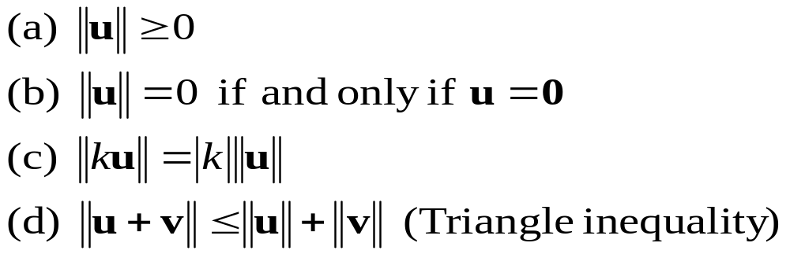
Theorem 4.1.4
Properties of Length in R^{n}
If u and v are vectors in R^{n} and k is any scalar, then

Slide 15
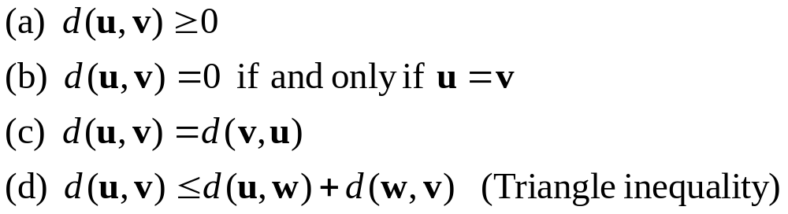
Theorem 4.1.5
Properties of Distance in R^{n}
If u, v, and w are vectors in R^{n} and k is any scalar, then:

Slide 16
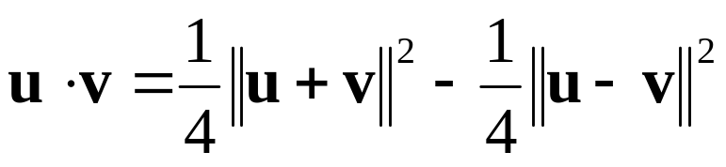
Theorem 4.1.6
If u, v, and w are vectors in R^{n} with the Euclidean inner product, then

Slide 17
Definition
Orthogonality
Two vectors u and v in R^{n} are called orthogonal if u٠v=0

Slide 18
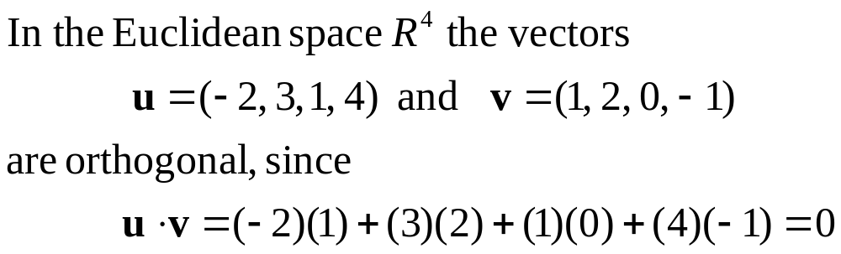
Example 4
Orthogonal Vector in R⁴

Slide 19
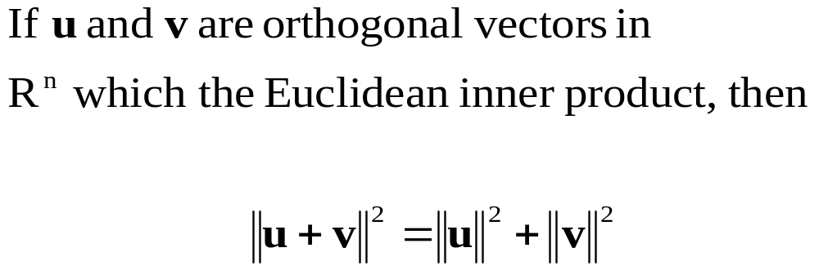
Theorem 4,1,7
Pythagorean Theorem in R^{n}

Slide 20
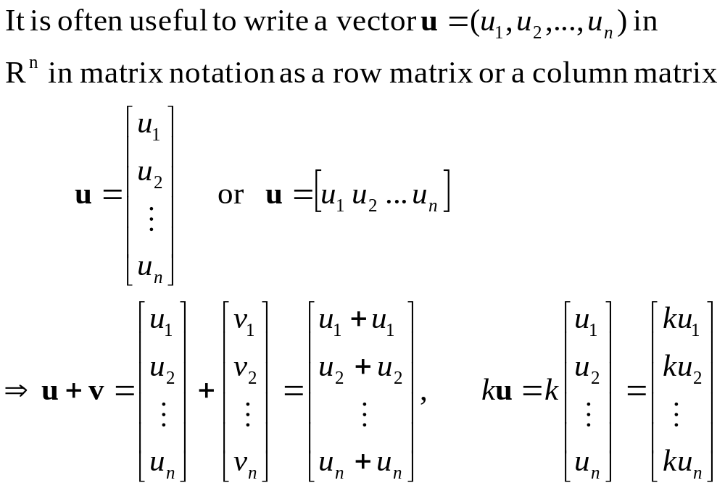
Alternative Notations for Vectors in R^{n} (1/2)

Slide 21
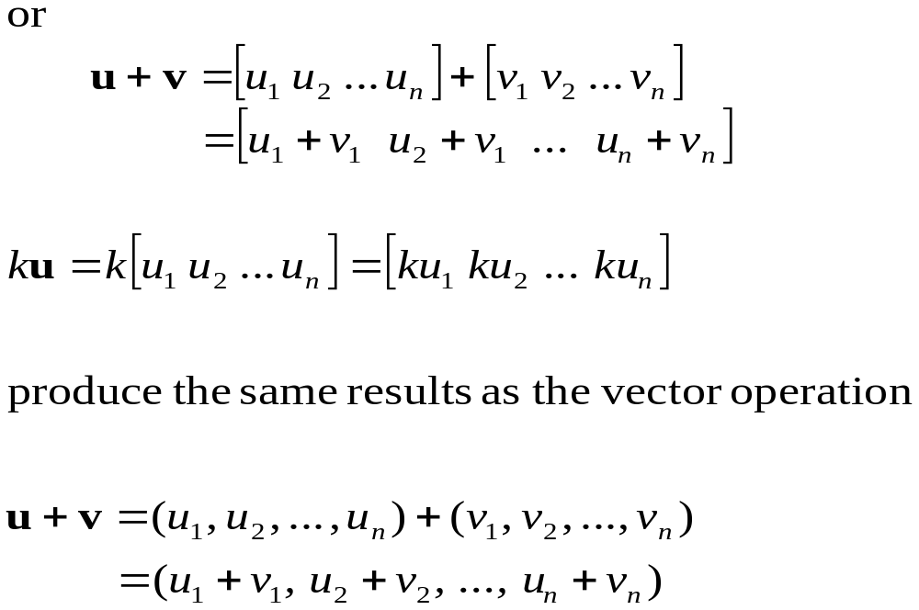

Alternative Notations for Vectors in R^{n} (2/2)

Slide 22
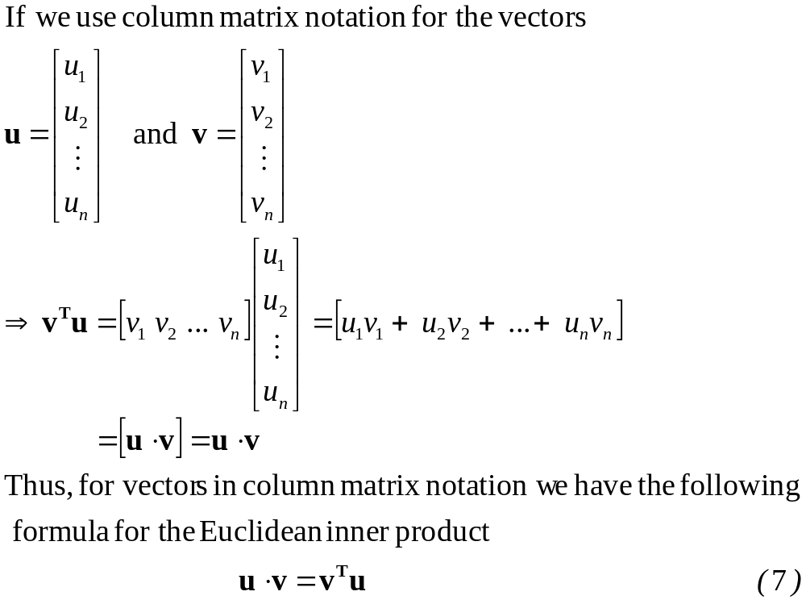
A Matrix Formula for the Dot Product(1/2)

Slide 23
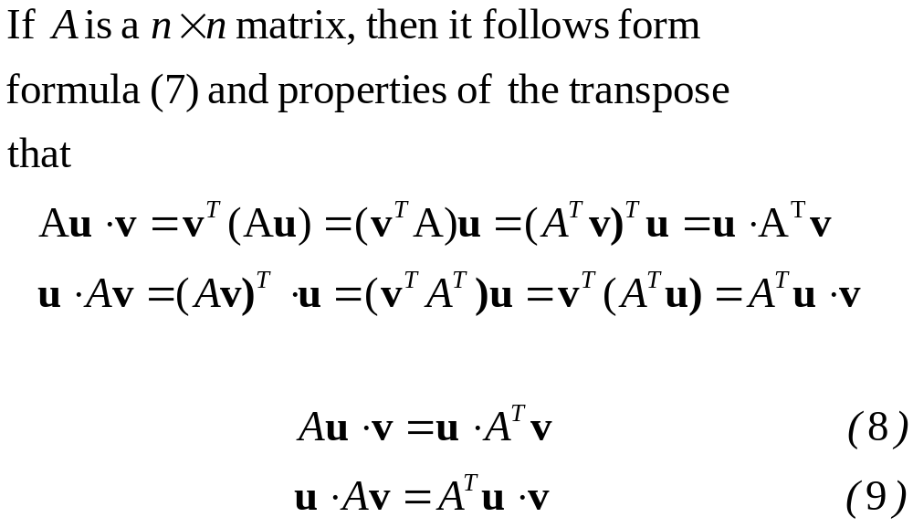
A Matrix Formula for the Dot Product(2/2)

Slide 24
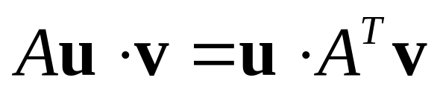
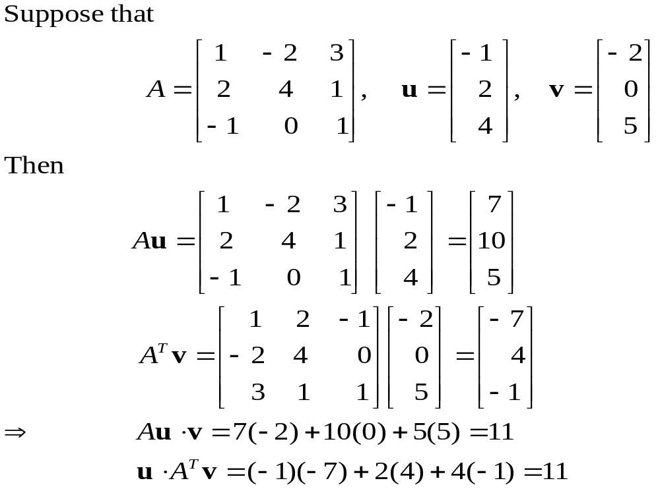
Example 5
Verifying That

Slide 25
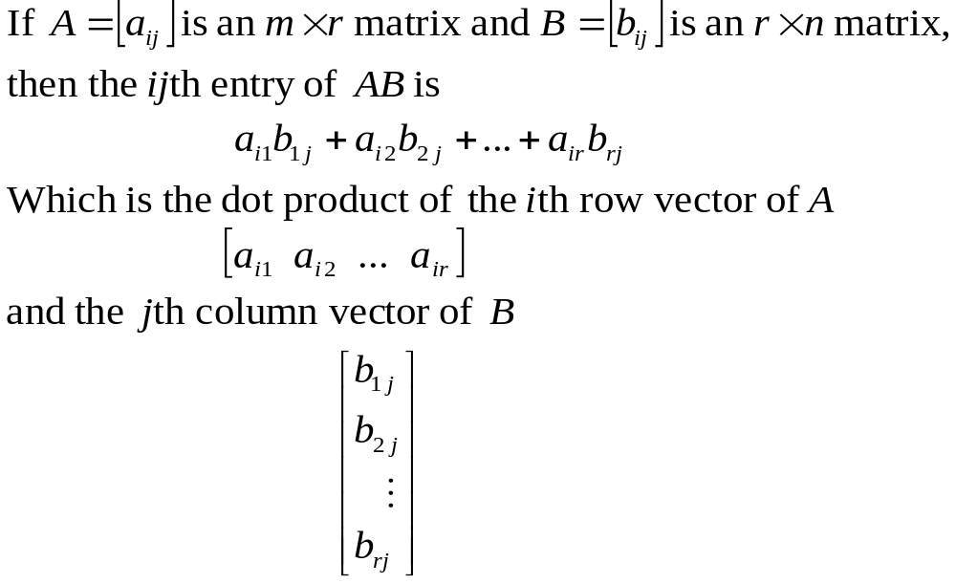
A Dot Product View of Matrix Multiplication (1/2)

Slide 26
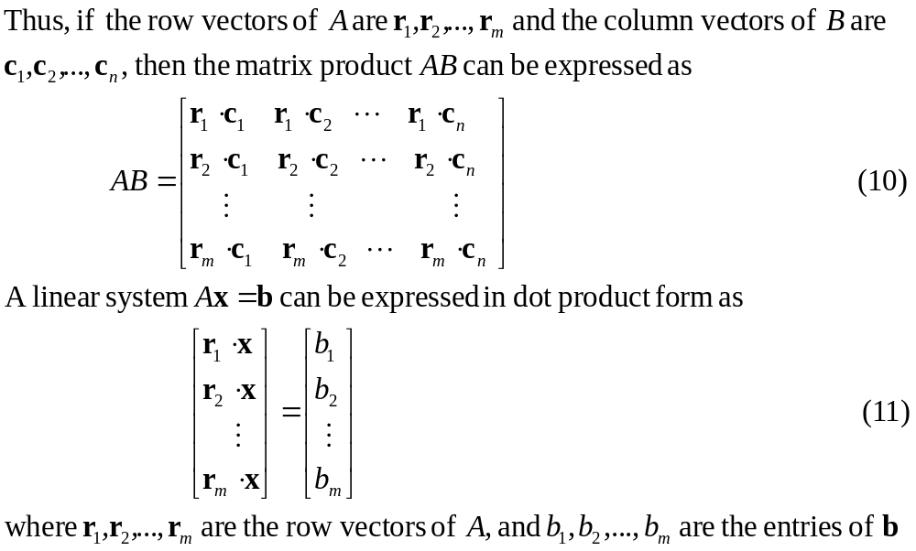
A Dot Product View of Matrix Multiplication (2/2)

Slide 27
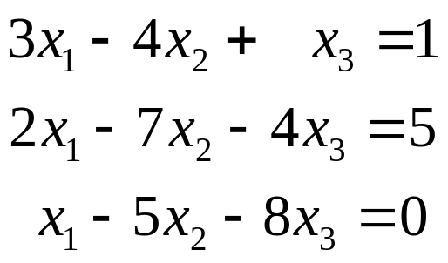
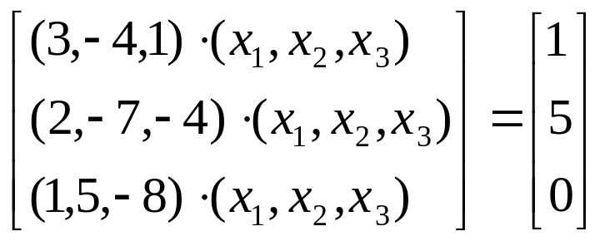
Example 6
A Linear System Written in Dot Product Form
System
Dot Product Form

Slide 28
4.2 Linear Transformations From R^{n} to R^{m}

Slide 29




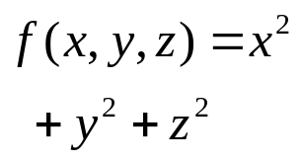

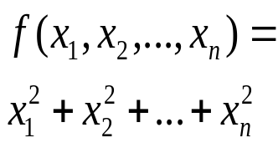

Functions from R^{n} to R
Formula | Example | Classification | Description
 |  | Real-valued function of a real variable | Function from R to R
 |  | Real-valued function of two real variable | Function from R² to R
 |  | Real-valued function of three real variable | Function from R³ to R
 |  | Real-valued function of n real variable | Function from R^{n} to R

Slide 30


Functions from R^{n} to R^{m} (1/2)
If the domain of a function f is R^{n} and the codomain is R^{m}, then f is called a map or transformation from R^{n} to R^{m} , and we say that the function f maps R^{n} into R^{m}. We denote this by writing f :
In the case where m=n the transformation f : is called an operator on R^{n}

Slide 31


Functions from R^{n} to R^{m} (2/2)
Suppose that f₁,f₂,…,f_{m} are real-valued functions of n real variables, say
    w₁=f₁ (x₁,x₂,…,x_{n})
    w₂=f₂ (x₁,x₂,…,x_{n})
    w_{m}=f_{m} (x₁,x₂,…,x_{n})
These m equations assign a unique point (w₁,w₂,…,w_{m}) in R^{m} to each point (x₁,x₂,…,x_{n}) in R^{n} and thus define a transformation from R^{n} to R^{m}. If we denote this transformation by T: then
T (x₁,x₂,…,x_{n})= (w₁,w₂,…,w_{m})

Slide 32
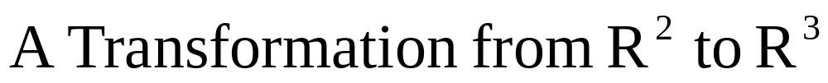
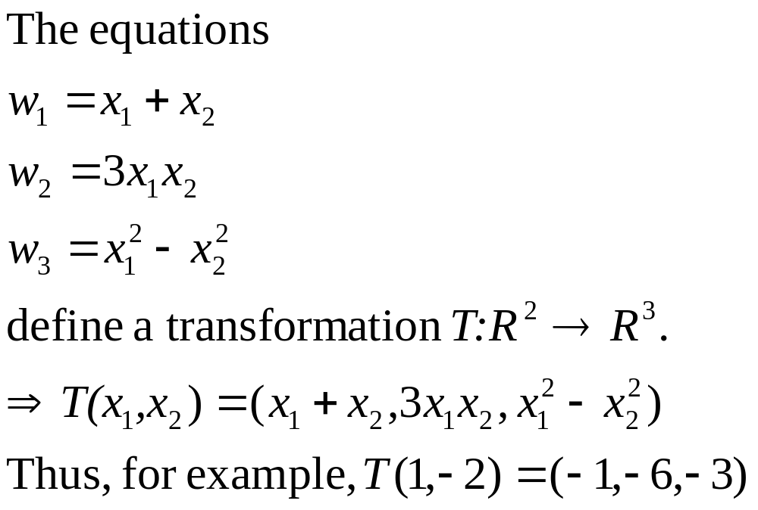
Example 1

Slide 33


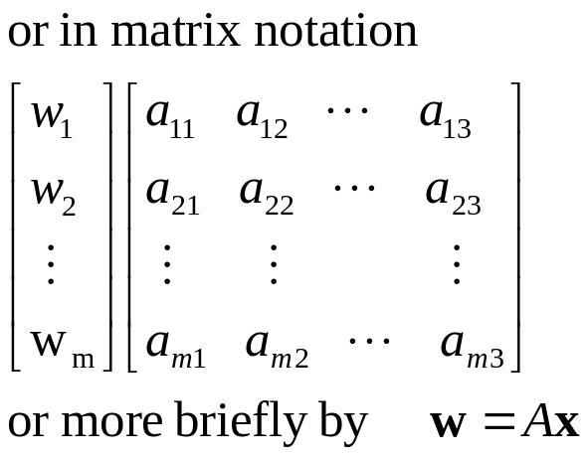
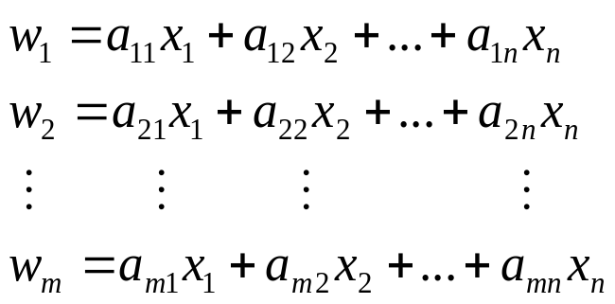
The transformation define by those equations is called a linear transformation ( or a linear operator if m=n ). Thus, a linear transformation is defined by equations of the form
The matrix A=[a_{ij}] is called the standard matrix for the linear transformation T, and T is called multiplication by A

Slide 34
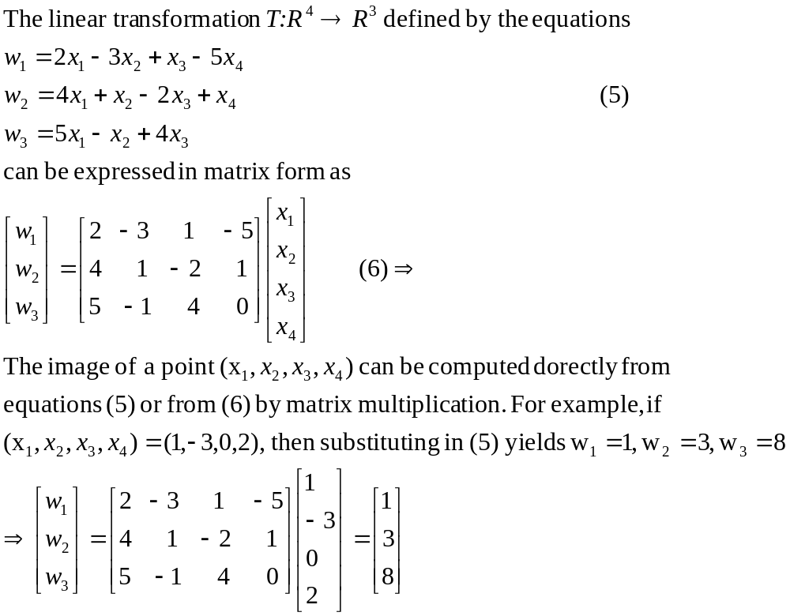
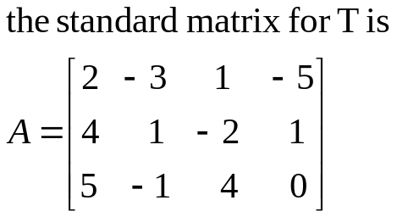
Example 2
A Linear Transformation from R⁴ to R³

Slide 35






Some Notational Matters
We denote the linear transformation by Thus,
The vector is expressed as a column matrix.
We will denote the standard matrix for T by the symbol [T].
Occasionally, the two notations for standard matrix will be mixed, in which case we have the relationship

Slide 36
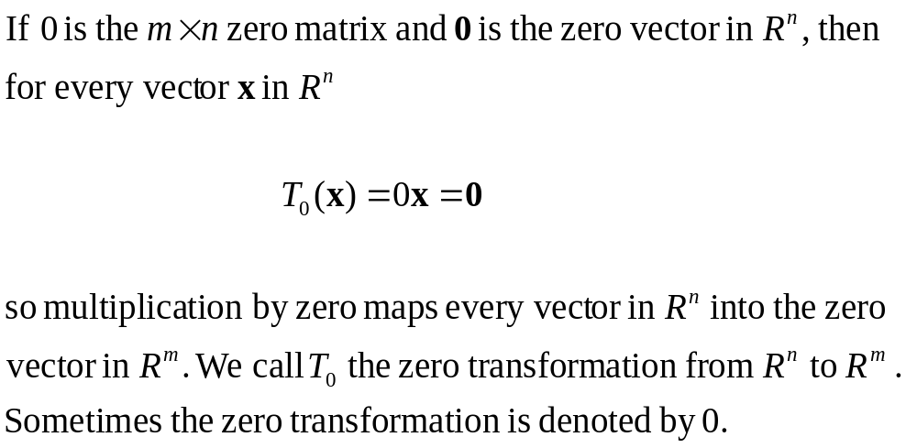
Example 3
Zero Transformation from R^{n} to R^{m}

Slide 37
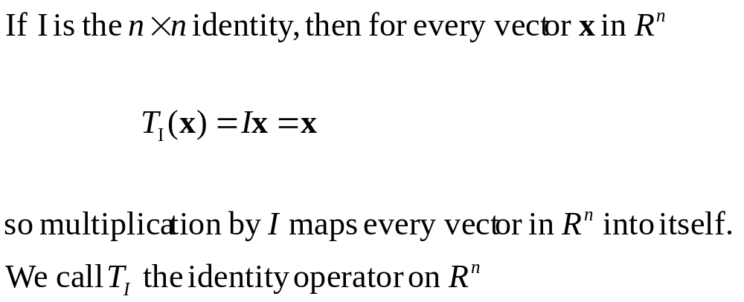
Example 4
Identity Operator on R^{n}

Slide 38
Reflection Operators
In general, operators on R² and R³ that map each vector into its symmetric image about some line or plane are called reflection operators. Such operators are linear.
Tables 2 and 3 list some of the common reflection operators

Slide 39
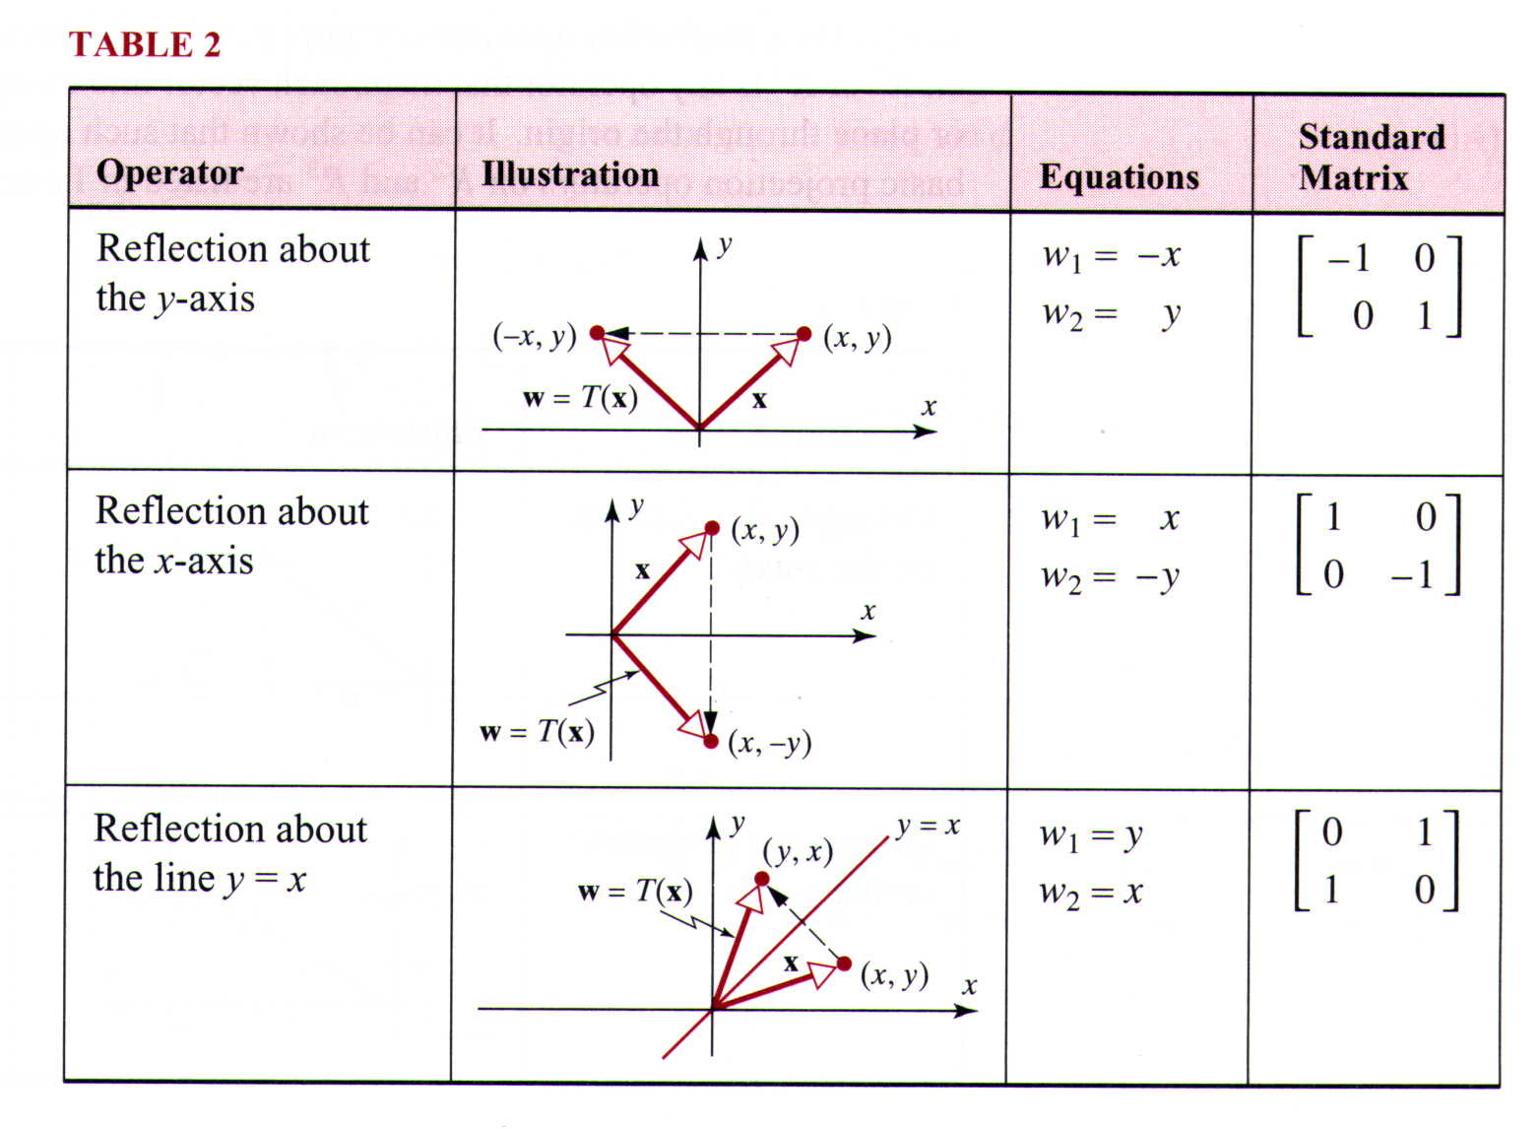
Table 2

Slide 40
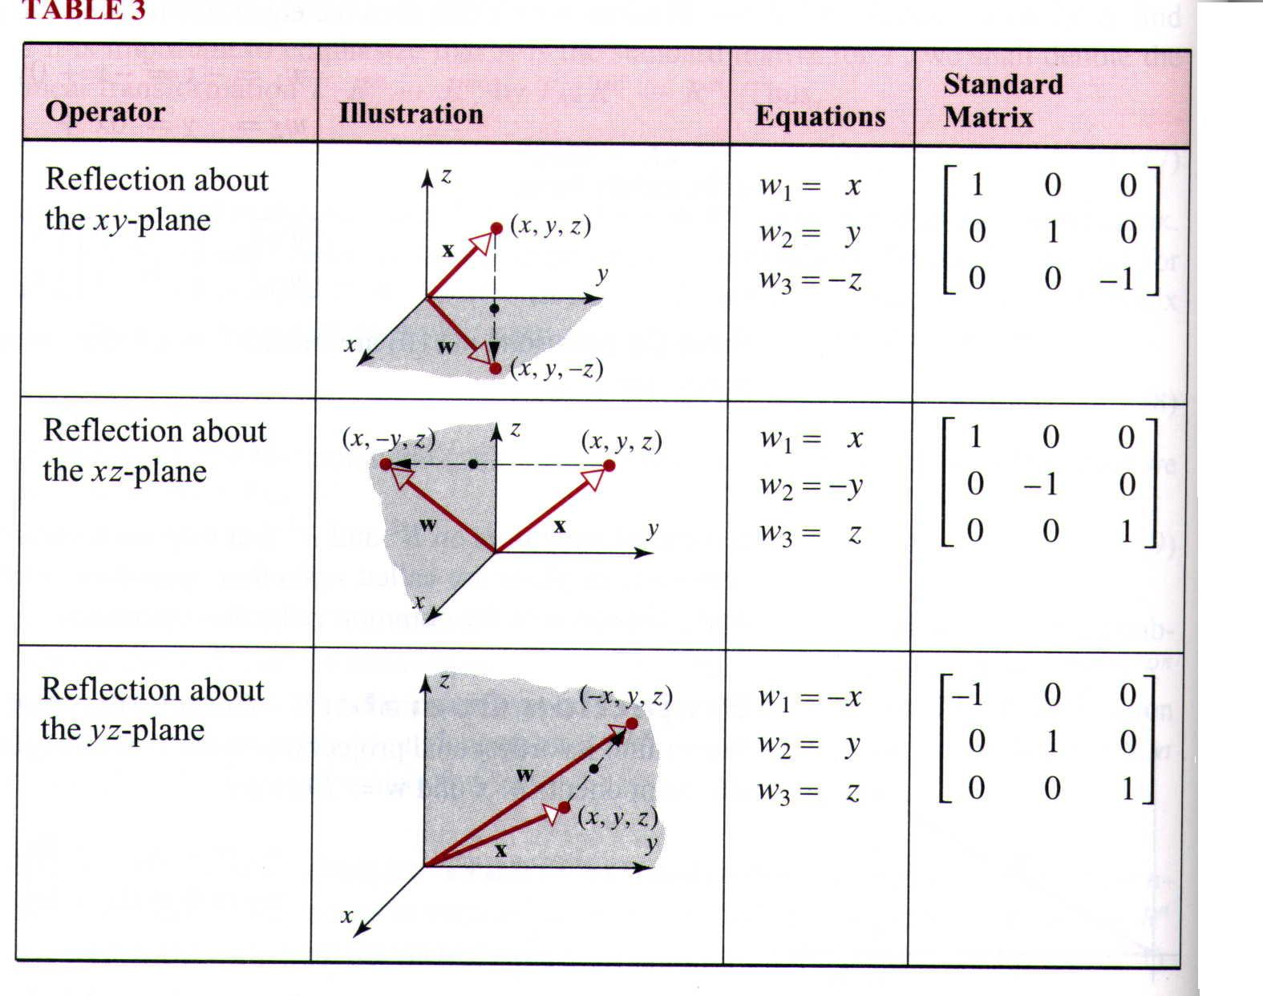
Table 3

Slide 41
Projection Operators
In general, a projection operator (or more precisely an orthogonal projection operator ) on R² or R³ is any operator that maps each vector into its orthogonal projection on a line or plane through the origin. It can be shown that operators are linear.
Some of the basic projection operators on R² and R³ are listed in Tables 4 and 5.

Slide 42
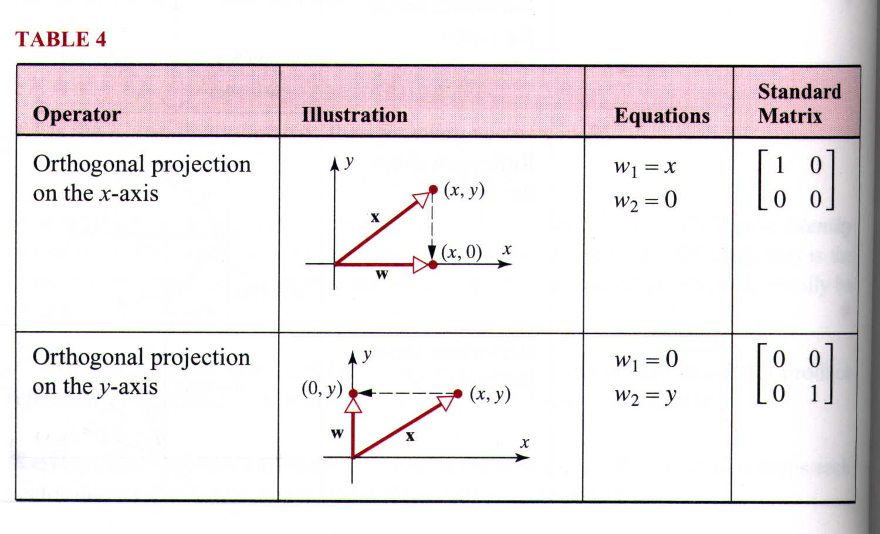
Table 4

Slide 43
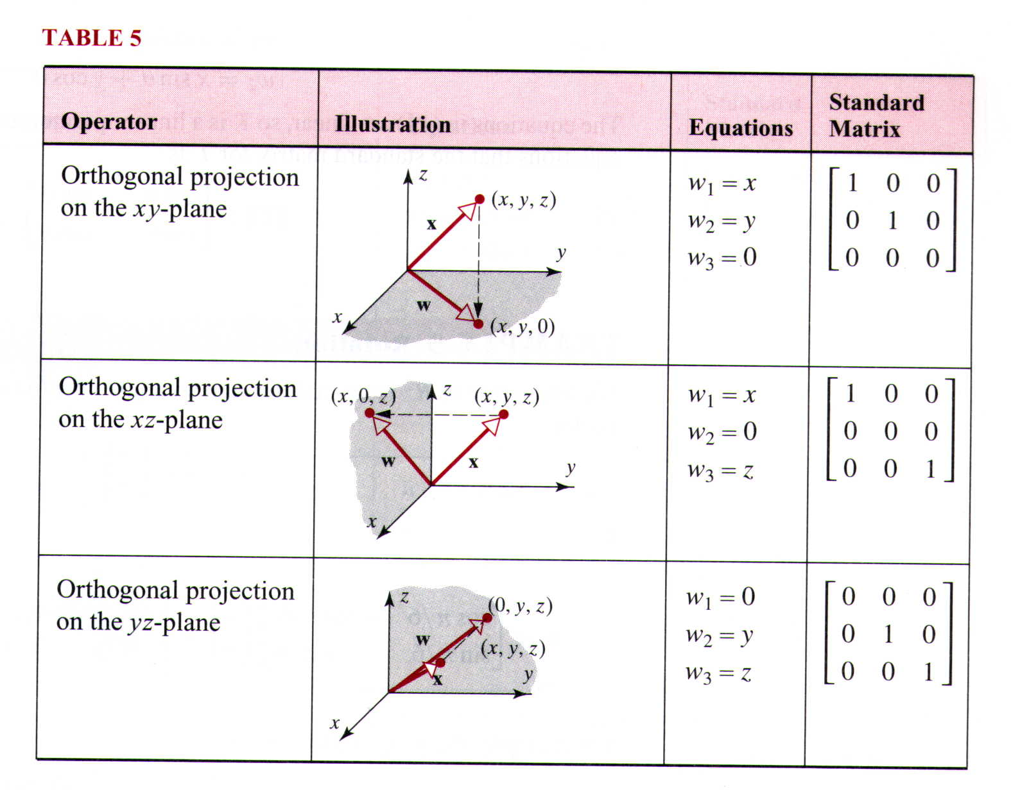
Table 5

Slide 44
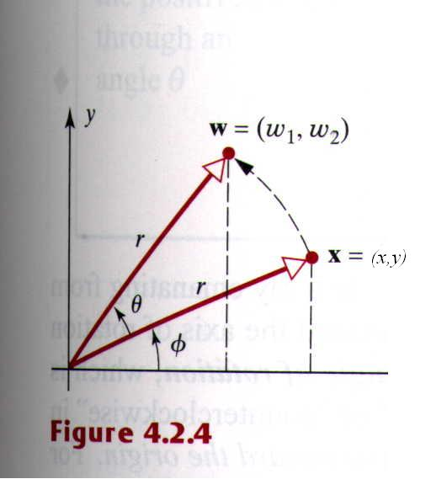





Rotation Operators (1/2)
An operator that rotate each vector in R² through a fixed angle is called a rotation operator on R². Table 6 gives formulas for the rotation operator on R².
Consider the rotation operator that rotates each vector counterclockwise through a fixed angle . To find equations relating and ,let be the positive -axis to ,and let r be the common length of and (figure 4.2.4)

Slide 45
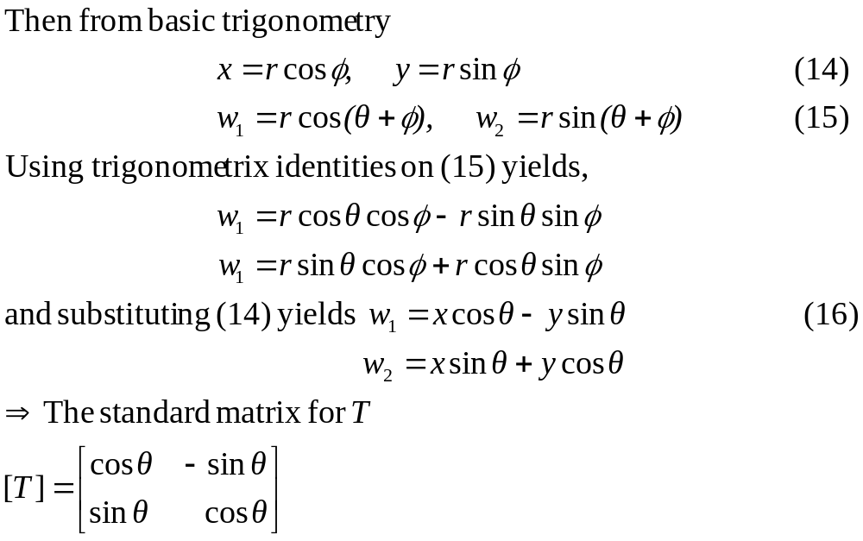
Rotation Operators (2/2)

Slide 46
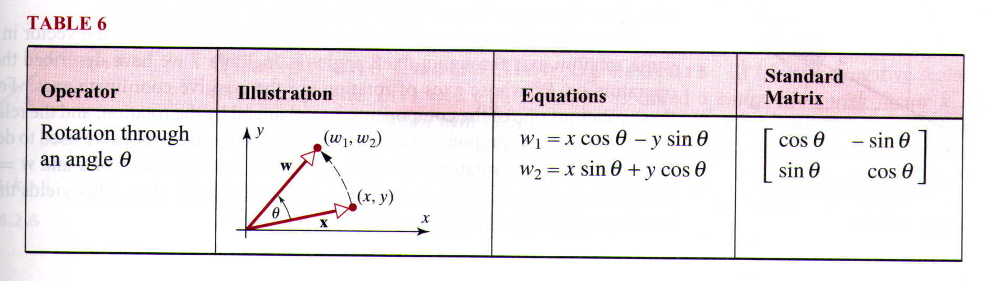
Table 6

Slide 47
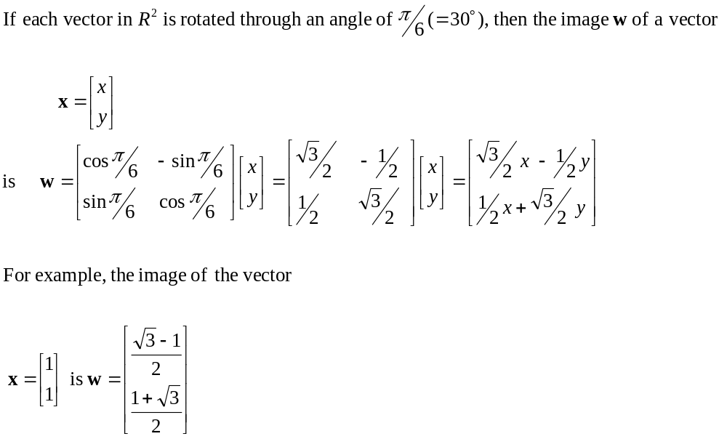
Example 5
Rotation

Slide 48
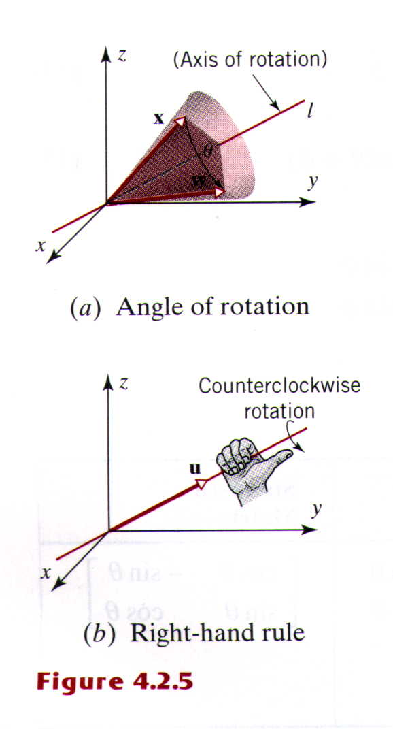
A Rotation of Vectors in R³(1/3)
A Rotation of Vectors in R³ is usually described in relation to a ray emanating from the origin, called the axis of rotation. As a vector revolves around the axis of rotation it sweeps out some portion of a cone (figure 4.2.5a). The angle of rotation is described as “clockwise” or “counterclockwise” in relation to a viewpoint that is along the axis of rotation looking toward the origin.
For example, in figure 4.2.5a , angles are positive if they are generated by counterclockwise rotations and negative if they are generated by clockwise.
The most common way of describing a general axis of rotation is to specify a nonzero vector u that runs along the axis of rotation and has its initial point at the origin. The counterclockwise direction for a rotation about its axis can be determined by a “right-hand rule” (Figure 4.2.5 b)

Slide 49
A Rotation of Vectors in R³(2/3)
A rotation operator on R³ is a linear operator that rotates each vector in R³ about some rotation axis through a fixed angle .
In table 7 we have described the rotation operators on R³ whose axes of rotation are positive coordinate axes.

Slide 50
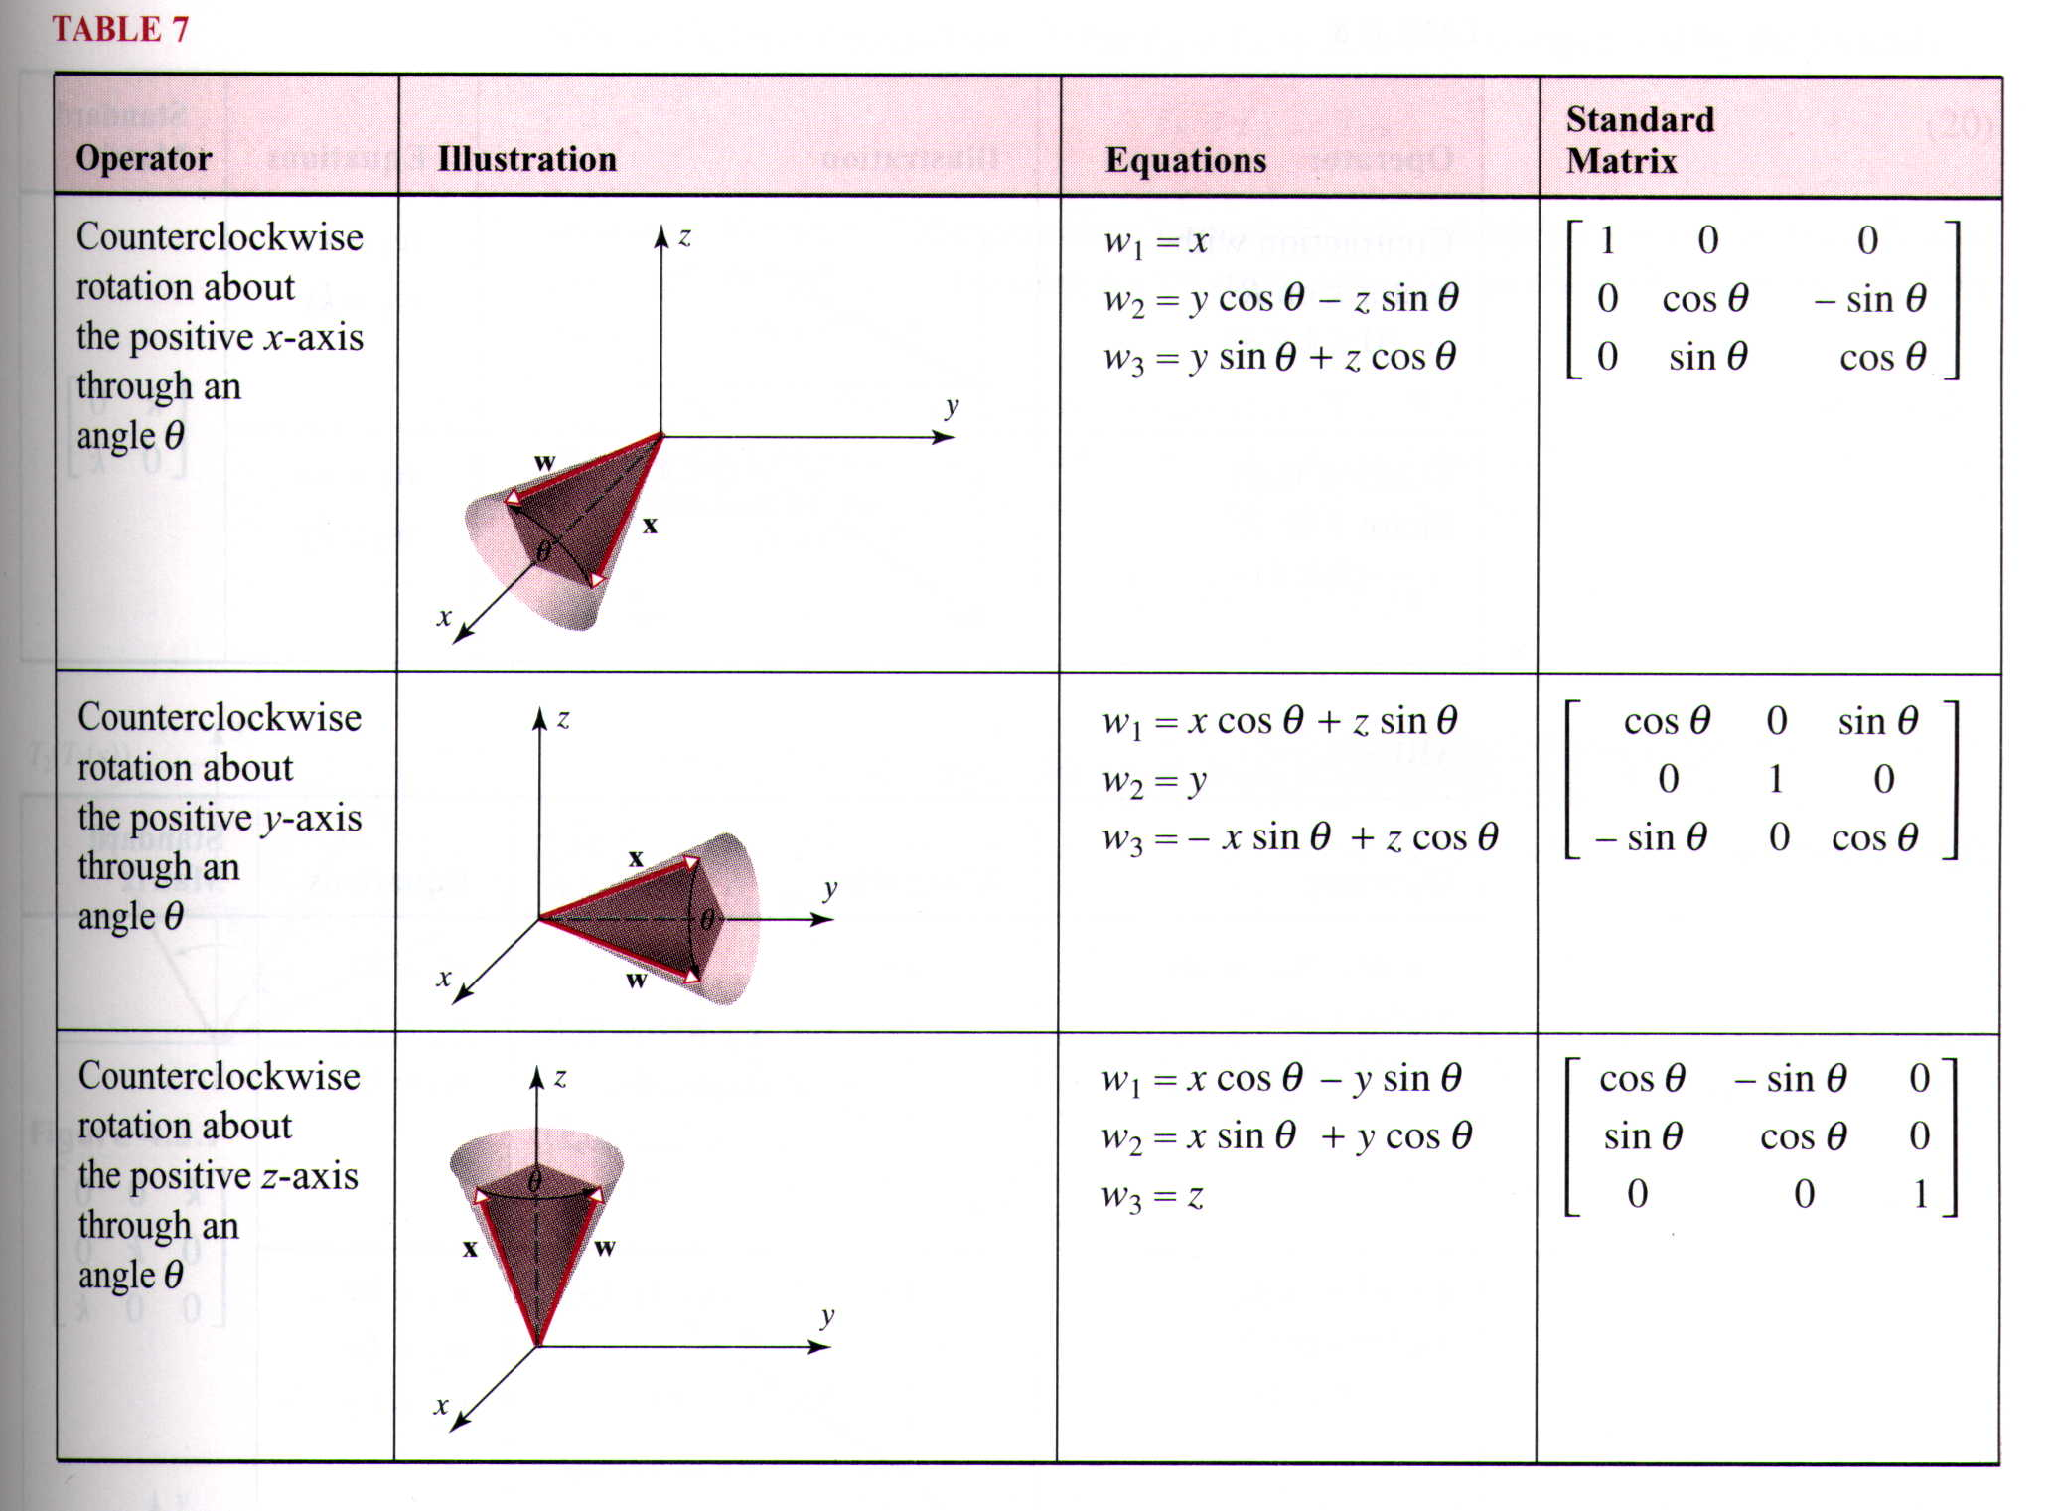
Table 7

Slide 51

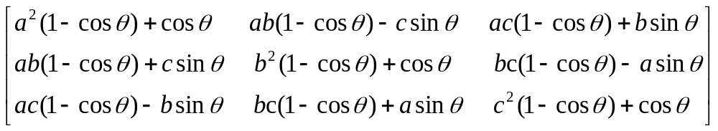
A Rotation of Vectors in R³(3/3)
We note that the standard matrix for a counterclockwise rotation through an angle about an axis in R³, which is determined by an arbitrary unit vector that has its initial point at the origin, is

Slide 52



Dilation and Contraction Operators
If is a nonnegative scalar, the operator on R² or R³ is called a contraction with factor if
and a dilation with factor if .
Table 8 and 9 list the dilation and contraction operators on R² and R³

Slide 53
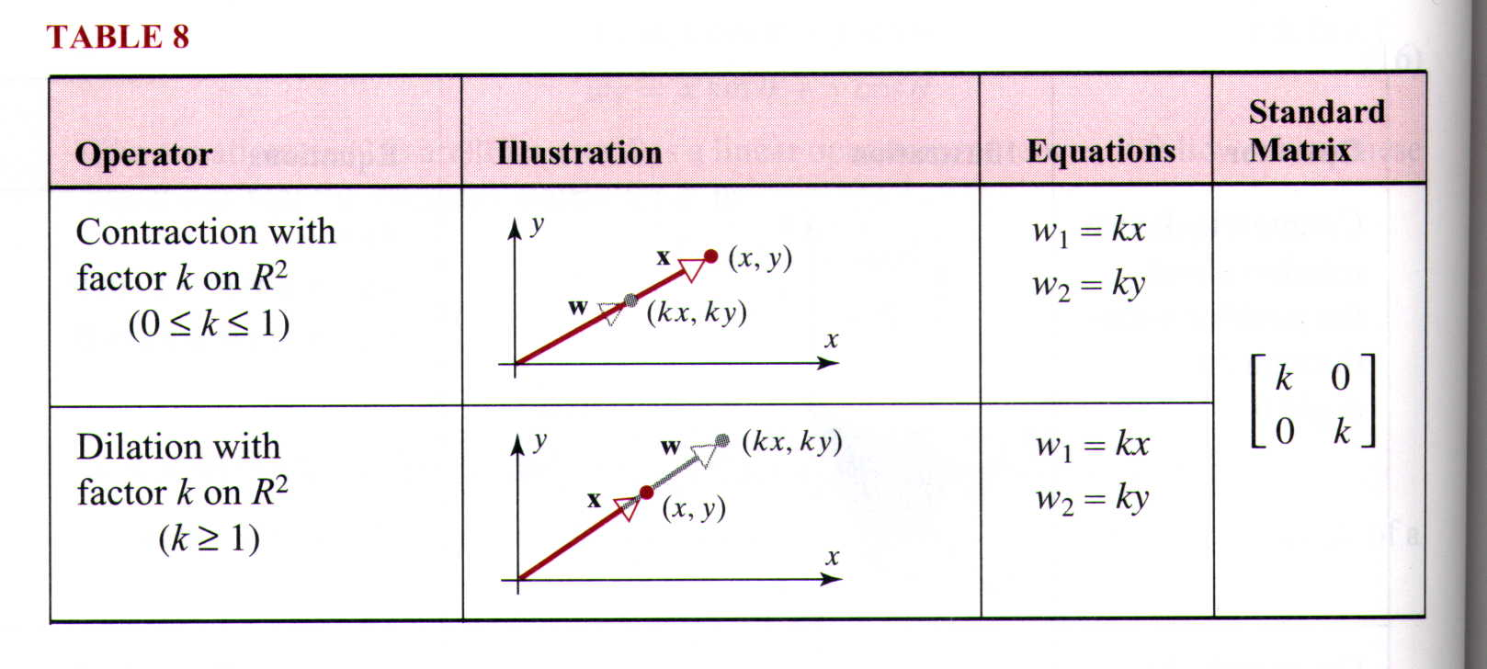
Table 8

Slide 54
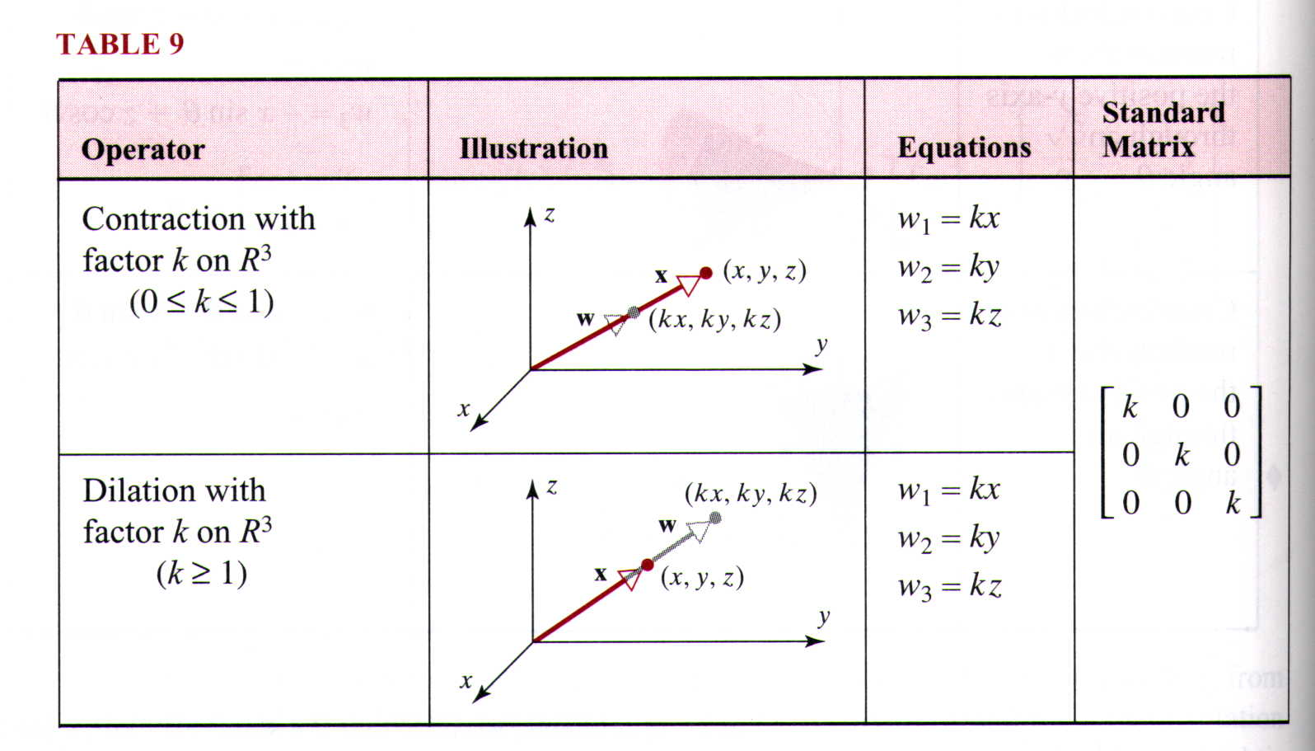
Table 9

Slide 55
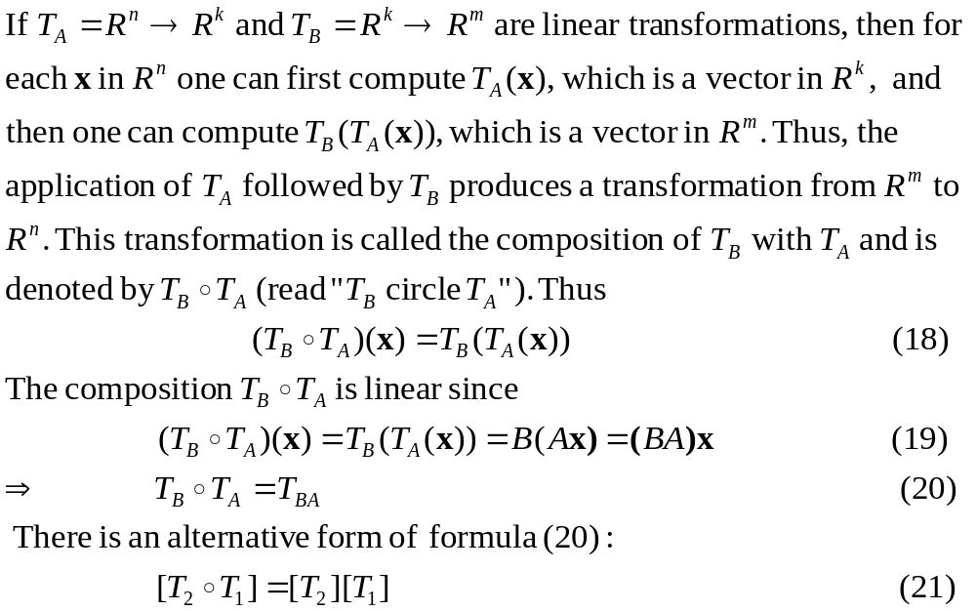
Compositions of Linear Transformations

Slide 56


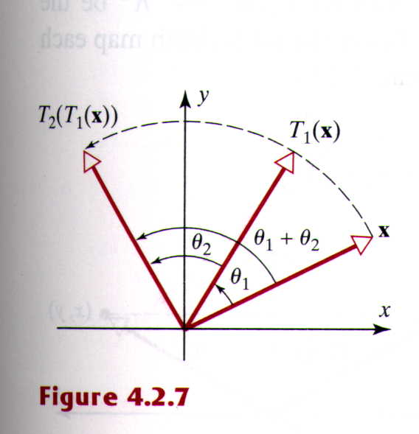






Example 6
Composition of Two Rotations(1/2)
Let and be linear operators that rotate vectors through the angle and ,respective. Thus the operation
first rotates through the angle , then rotates through the angle . It follows that the net effect of
is to rotate each vector in R² through the angle (figure 4.2.7)

Slide 57
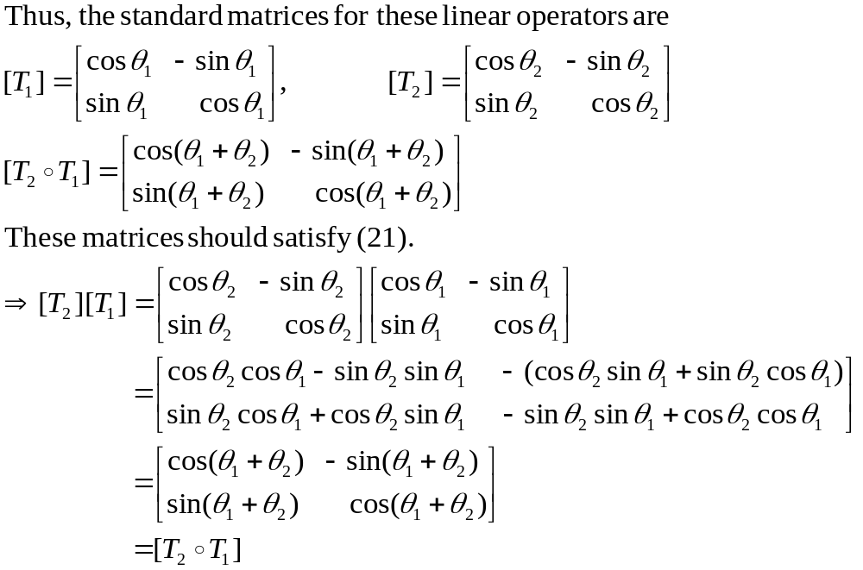
Example 6
Composition of Two Rotations(2/2)

Slide 58
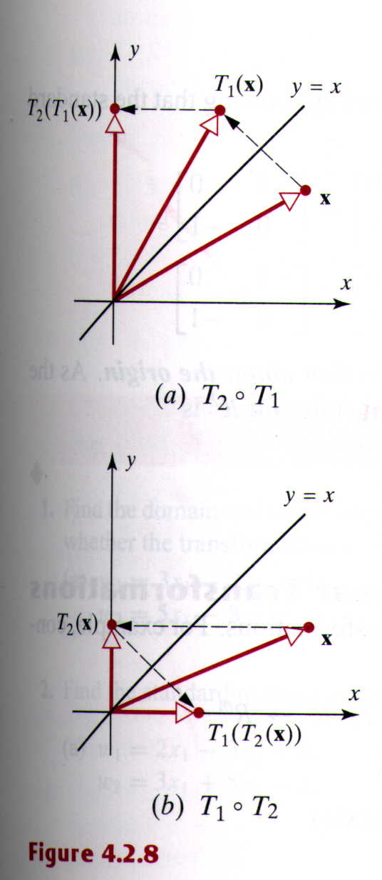






Example 7
Composition Is Not Commutative(1/2)
Let be the reflection operator about the line ,and let be the orthogonal projection on the -axis. Figure 4.2.8 illustrates graphically that and have different effect on a vector . This same conclusion can be reached by showing that the standard matrices for and do not commute:

Slide 59
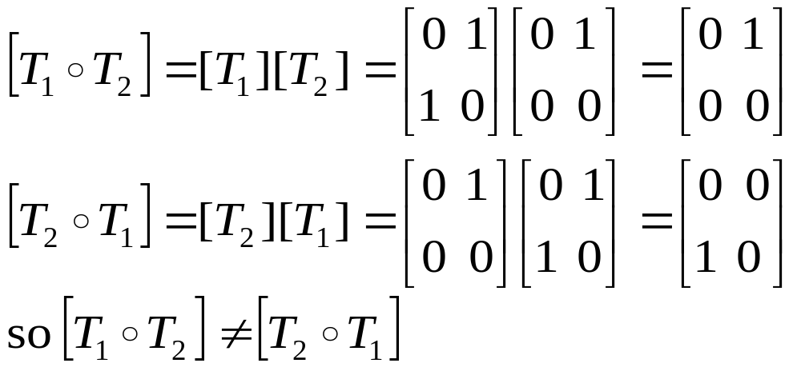
Example 7
Composition Is Not Commutative(2/2)

Slide 60


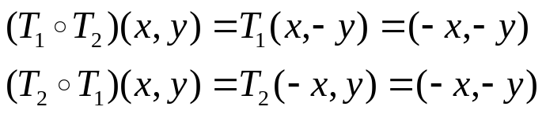
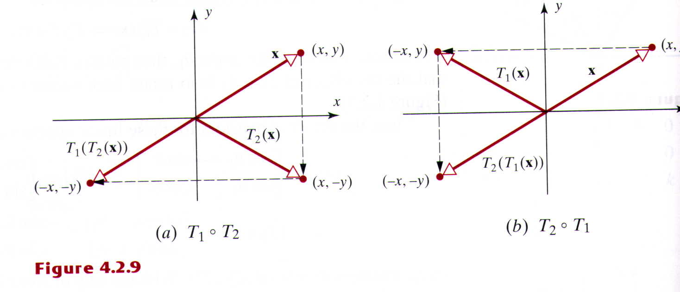
Example 8
Composition of Two Reflections(1/2)
Let be the reflection about the -axis, and let be the reflection about the -axis. In this case and are the same; both map each vector into negative
(Figure 4.2.9)

Slide 61
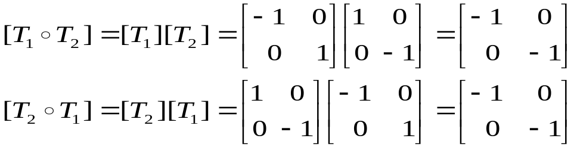


Example 8
Composition of Two Reflections(2/2)
The equality and can also be deduced by showing that the standard matrices for and commute
The operator on R² or R³ is called the reflection about the origin. As the computations above show, the standard matrix for this operator on R² is

Slide 62







Compositions of Three or More Linear Transformations
Compositions can be defined for three or more linear transformations. For example, consider the linear transformations
We define the composition by
It can be shown that this composition is a linear transformation and that the standard matrix for is related to the standard matrices for , , and by
which is a generalization of (21) . If the standard matrices for
, , and are denoted by A, B, and C, respectively, then we also have the following generalization of (20):

Slide 63






Example 9
Composition of Three Transformations(1/2)
Find the standard matrix for the linear operator
that first rotates a vector counterclockwise about the -axis through an angle , then reflects the resulting vector about the -plane, and then projects that vector orthogonally onto the -plane.
Solution:
The linear transformation T can be expressed as the composition , where T₁ is the rotation about the -axis, T₂ is the rotation about the -plane, T₃ is the rotation about the -plane. From Tables 3,5, and 7 the standard matrices for these linear transformations are

Slide 64

Example 9
Composition of Three Transformations(2/2)

Slide 65
4.3 Properties of Linear Transformations from R^{n} to R^{m}

Slide 66
Definition
One-to-One Linear transformations
A linear transformation T=R^{n} →R^{m} is said to be one-to-one if T maps distinct vectors (points) in R^{n} into distinct vectors (points) in R^{m}

Slide 67


Example 1
One-to-One Linear Transformations
In the terminology of the preceding definition, the rotation operator of Figure 4.3.1 is one-to-one, but the orthogonal projection operator of Figure 4.3.2 is not

Slide 68
Theorem 4.3.1
Equivalent Statements
If A is an nxn matrix and T_{A}: R^{n}→R^{n} is multiplication by A, then the following statements are equivalent.
(a) A is invertible
(b) The range of T_{A} is R^{n}
(c) T_{A} is one-to-one

Slide 69



Example 2
Applying Theorem 4.3.1
In Example 1 we observed that the rotation operator T: R²→R² illustrated in Figure 4.3.1 is one-to-one. It follows from Theorem 4.3.1 that the range of T must be all of R² and that the standard matrix for T must be invertible. To show that the range of T is all of R², we must show that every vector w in R² is the image of some vector x under T. But this is clearly so, since the vector x obtained by rotating w through the angle - maps into w when rotated through the angle . Moreover, from Table 6 of Section 4.2, the standard matrix for T is
Which is invertible, since

Slide 70

Example 3
Applying Theorem 4.3.1
In Example 1 we observed that the projection operator T: R³→R³ illustrated in Figure 4.3.2 is not one-to-one. It follows from Theorem 4.3.1 that the range of T is not all of R³ and the standard matrix for T is not invertible. To show that the range of T is not all of R³, we must find a vector w in R³ that is not the image of any vector x under T. But any vector w outside of the xy-plane has this property, since all images under T lie in the xy-plane. Moreover, from Table 5 of Section 4.2, the standard matrix for T is
which is not invertible, since det[T]=0

Slide 71






Inverse of a One-to-One Linear Operator(1/2)
If T_{A}=R^{n} →R^{n} is a one-to-one linear operator, then from Theorem 4.3.1 the matrix A is invertible. Thus, is itself a linear operator; it is called the inverse of T_{A}. The linear operators T_{A} and cancel the effect of one another in the sense that for all x in R^{n}
or equivalently,
If w is the image of x under T_{A}, then maps w back into x, since

Slide 72
Inverse of a One-to-One Linear Operator(2/2)
When a one-to-one linear operator on R^{n} is written as T:R^{n}→R^{n}, then the inverse of the operator T is denoted by T⁻¹. since the standard matrix for T⁻¹ is the inverse of the standard matrix for T, we have
[T⁻¹]=[T]⁻¹

Slide 73





Example 4
Standard Matrix for T⁻¹
Let T: R²→R² be the operator that rotates each vector in R² through the angle ;so from Table 6 of Section 4.2
It is evident geometrically that to undo the effect of T one must rotate each vector in R² through the angle .But this is exactly what the operator T⁻¹ does, since the standard matrix T⁻¹ is
,which is identical to (2) except that is replaced by

Slide 74


Example 5
Finding T⁻¹ (1/2)
Show that the linear operator T: R²→R² defined by the equations w₁=2x₁+ x₂
w₂=3x₁+4x₂
is one-to-one, and find T⁻¹(w₁, w₂)
Solution:
The matrix form of these equations is
so the standard matrix for T is

Slide 75



Example 5
Finding T⁻¹ (2/2)
This matrix is invertible (so T is one-to-one) and the standard matrix for T⁻¹ is
Thus,
from which we conclude that

Slide 76
Theorem 4.3.2
Properties of Linear Transformations
A T: R^{n}→R^{m} is linear if and only if the following relationships hold for all vectors u and v in R^{n} and every scalar c
  (a) T(u+v) = T(u) + T(v)
  (b) T(cu) = cT(u)

Slide 77
Theorem 4.3.3
If T: R^{n}→R^{m} is a linear transformation, and e₁, e₂, …, e_{n} are the standard basis vectors for R^{n}, then the standard matrix for T is
[T]=[T(e₁)|T(e₂)|…|T(e_{n})] (6)

Slide 78






Example 6
Standard Matrix for a Projection Operator(1/3)
Let l be the line in the xy-plane that passes through the origin and makes an angle with the positive x-axis, where . As illustrated in Figure 4.3.5a, let T: R²→R² be a linear operator that maps each vector into orthogonal projection on l.
(a) Find the standard matrix for T
(b) Find the orthogonal projection of the vector x=(1,5) onto the line through the origin that makes an angle of with the positive x-axis
Figure 4.3.5
Solution (a): From (6)
[T]=[T(e₁)|T(e₂)]
where e₁ and e₂ are the standard basis vectors for R². We consider the case where ; the case where is similar.

Slide 79







Example 6
Standard Matrix for a Projection Operator(2/3)
Referring to Figure 4,3,5b, we have , so
and referring to Figure 4.3.5c, we have so
thus, the standard matrix for T is

Slide 80




Example 6
Standard Matrix for a Projection Operator(3/3)
Solution (b):
Since , it follows from part (a) that the standard matrix for this projection operator is
thus,
or in horizontal notation

Slide 81

Definition
If T: R^{n}→R^{n} is a linear operator, then a scalar is called an eigenvalue of T if there is a nonzero x in R^{n} such that
Those nonzero vectors x that satisfy this equation are called the eigenvectors of T corresponding to

Slide 82



Example 7
Eigenvalues of a Linear Operator(1/3)
Let T: R²→R² be the linear operator that rotates each vector through an angle . It is evident geometrically that unless is a multiple of , then T does not map any nonzero vector x onto the same line as x; consequently, T has no real eigenvalues. But if is a multiple of ,then every nonzero vector x is mapped onto the same line as x, so every nonzero vector is an eigenvector of T. Let us verify these geometric observations algebraically. The standard matrix for T is
As discussed in Section 2.3, the eigenvalues of this matrix are the solutions of the character equation

Slide 83












Example 7
Eigenvalues of a Linear Operator(2/3)
That is,
But if is not a multiple of , then , so this equation has no real solution for and consequently A has no real eigenvectors. If is a multiple of , then and either or , depending on the particular multiple of .In the case where and ,the characteristic equation (8) becomes , so
is the only eigenvalue of A. In the case the matrix A is
Thus, for all x in R²

Slide 84




Example 7
Eigenvalues of a Linear Operator(3/3)
So T maps every vector to itself, and hence to the same line. In the case where and , the characteristic equation (8) becomes , so that is the only eigenvalue of A. In this case the matrix A is
Thus, for all x in R² ,
so T maps every vector to its negative, and hence to the same line as x.

Slide 85



Example 8
Eigenvalues of a Linear Operator(1/3)
Let T: R³→R³ be the orthogonal projection on xy-plane. Vectors in the xy-plane are mapped into themselves under T, so each nonzero vector in the xy-plane is an eigenvector corresponding to the eigenvalue .Every vector x along the z-axis is mapped into 0 under T, which is on the same line as x, so every nonzero vector on the z-axis is an eigenvector corresponding to theei genvalue . Vectors not in the xy-plane or along the z-axis are mapped into scalar multiples of themselves, so there are no other eigenvectors or eigenvalues.
To verify these geometric observations algebraically, recall from Table 5 of Section 4.3 that the standard matrix for T is

Slide 86






Example 8
Eigenvalues of a Linear Operator(2/3)
The characteristic equation of A is
which has the solutions and anticipated above.
As discussed in Section 2.3, the eigenvectors of the matrix A corresponding to an eigenvalue are the nonzero solutions of
If , this system is

Slide 87




Example 8
Eigenvalues of a Linear Operator(3/3)
which has the solutions x₁=0,x₂=0,x₃=t (verify), or in matrix form
As anticipated, these are the vectors along the z-axis. If , then system (9) is
which has the solutiona x₁=s , x₂=t , x₃=0 , or in matrix form,
As anticipates, these are vectors in xy-plane

Slide 88

Theorem 4.3.4
Equivalent Statements
If A is an nxn matrix, and if T_{A}: R^{n}→R^{n} is multiplication by A , then the following are equivalent,
(a) A is invertible
(b) Ax=0 has only the trivial solution
(c) The reduced row-echelon form of A is I_{n}
(d) A is expressible as a product of elementary matrices
(e) Ax=b is consistent for every nx1 matrix b
(f) Ax=b has exactly one solution for every nx1 matrix b
(g)
(h) The range of T_{A} is R^{n}
(i) T_{A} is one-to-one

